Slide 1

Team Members Kusumanth Reddy-2000030539 Sandeep -2000031937 Ravi Teja -2000030682 - Team 233
SDP-1
Project
Event Management system

Slide 2
INtroduction
Event management is the using of management sciences if the filters and minor details of events at domestic and international level such as festivals, conferences, ceremonies, formal parties, concerts, or conventions.. It involves study of identifying the target audience, planning the logistics, devising the event concept, coordinating the technical aspects before getting down to actually executing the modalities of the event.

Slide 3
Modules
Customer Module – It is customer who has to take initiative for inputting the values for any event.
Event management – The events needs to be entered for the company to organize.
Sponsors management – Some events cannot do without sponsors so their arrangement and management has to be done.
Service Providers management – These are care taker of the event so work has to be allotted.

Slide 4
Functional Requirements -in Event management System
SITE MANAGEMENT
MARKETING
FINANCIAL & BUDGET MANAGEMENT
WORKING WITH SUPPLIERS & CONTRACTORS
STRATEGIC PLANNING & REVIEW
ADMINISTRATION

Slide 5
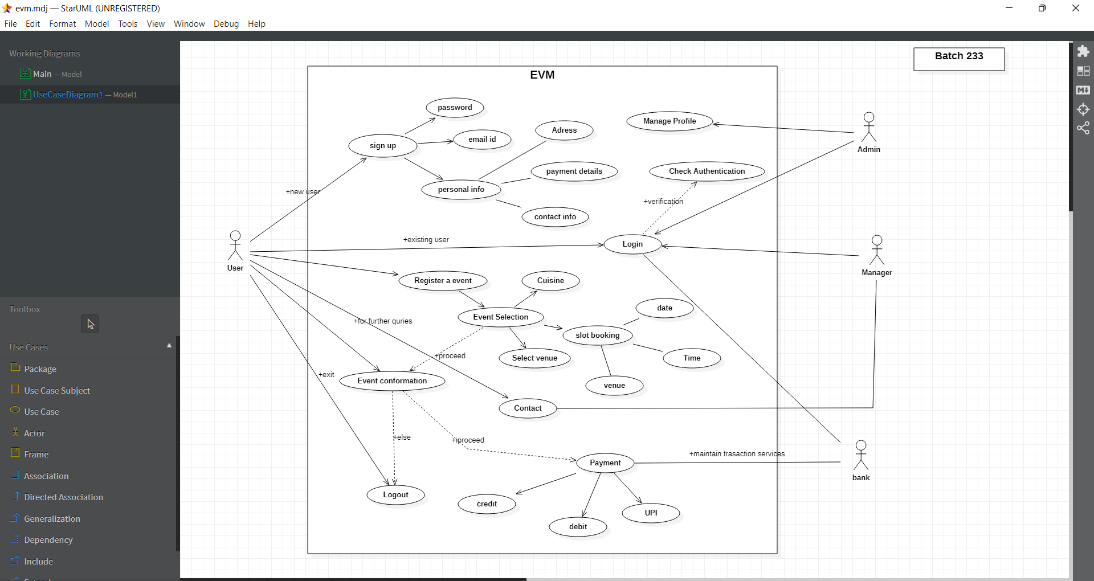
USE-Case Methodology

Slide 6
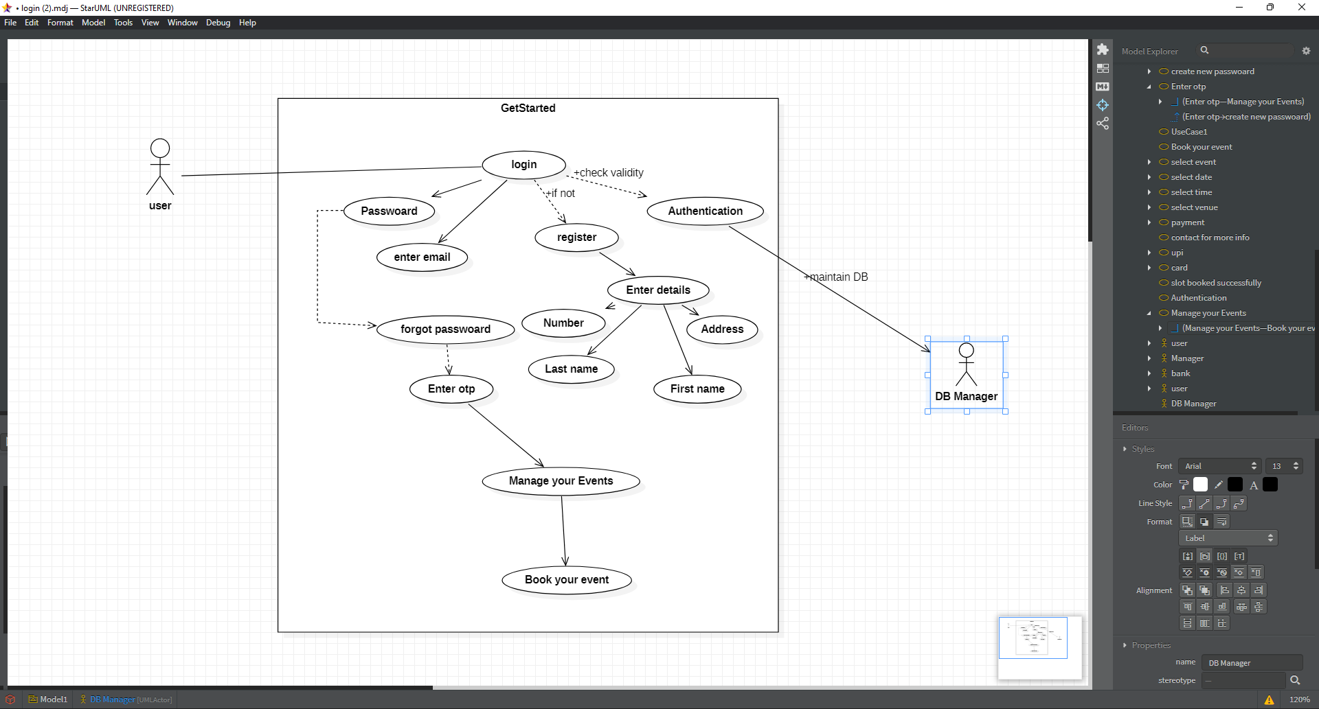
USE_CASE-2

Slide 7
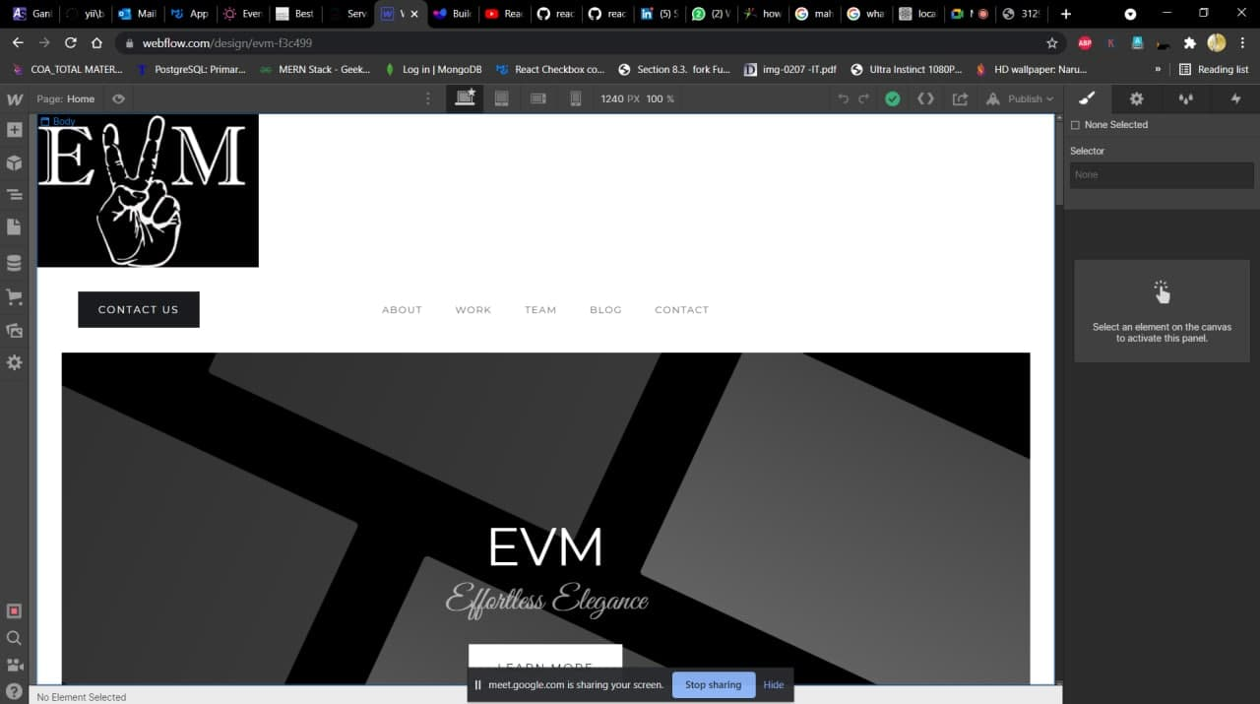
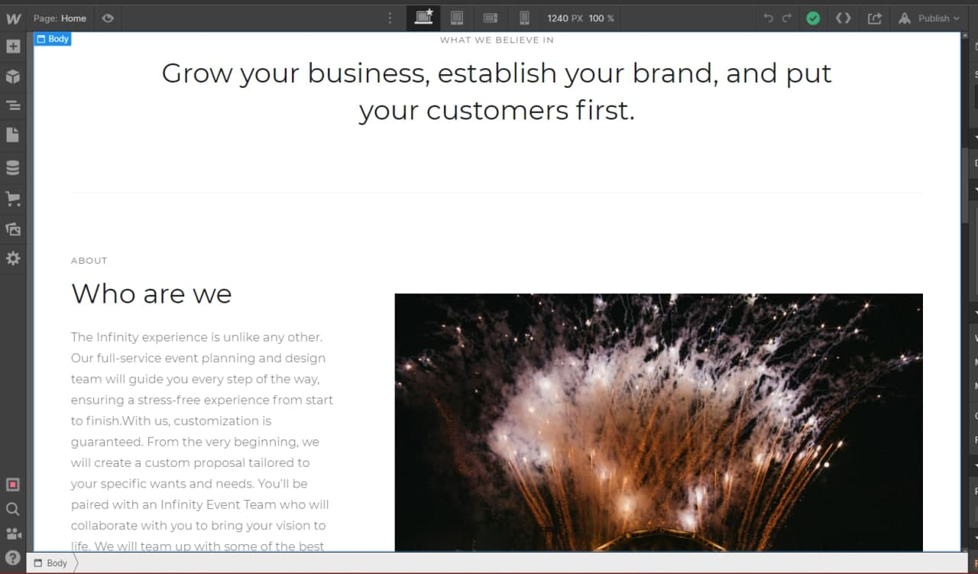
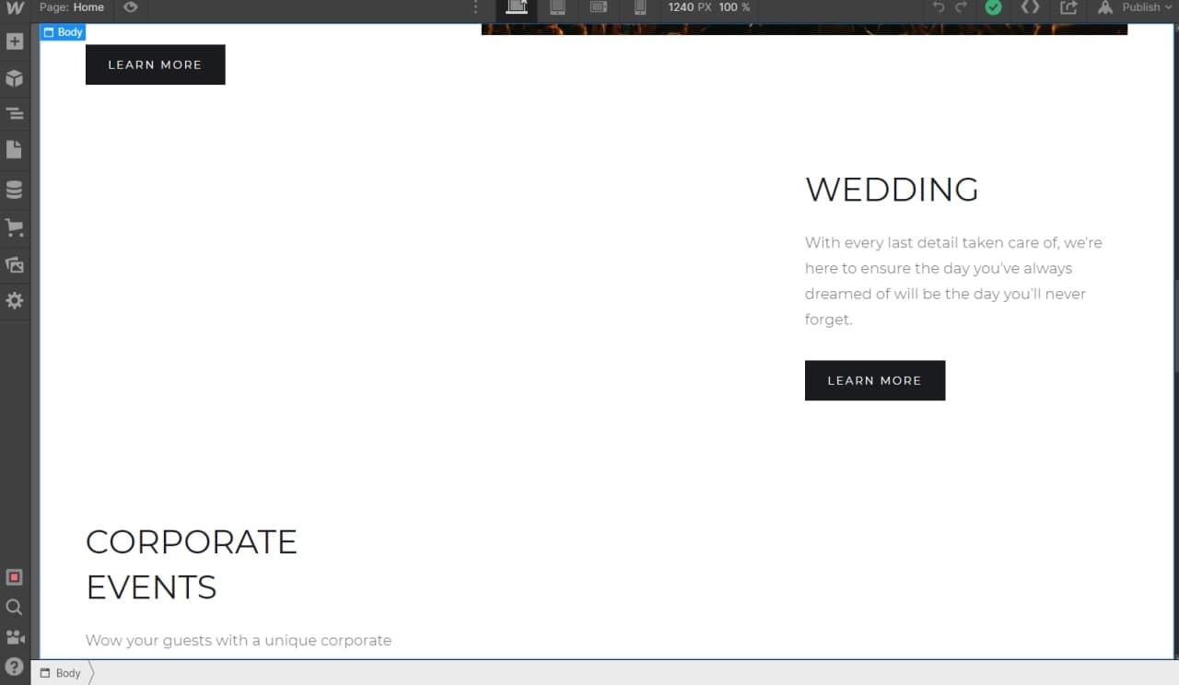
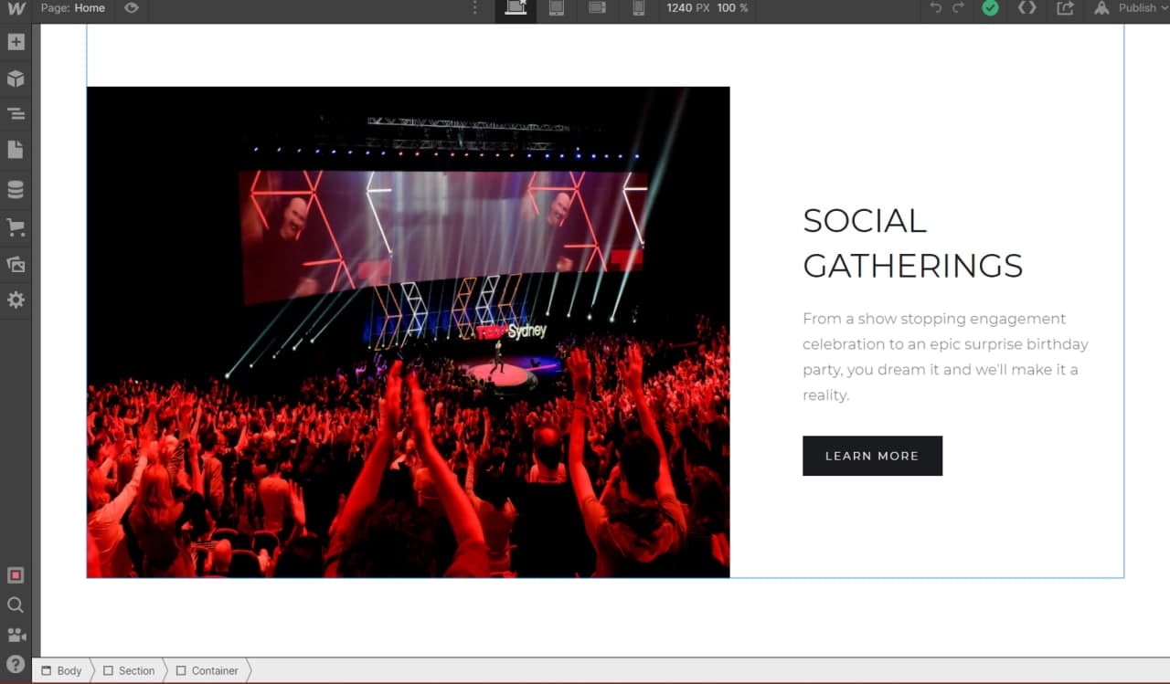
Designing of website

Slide 8
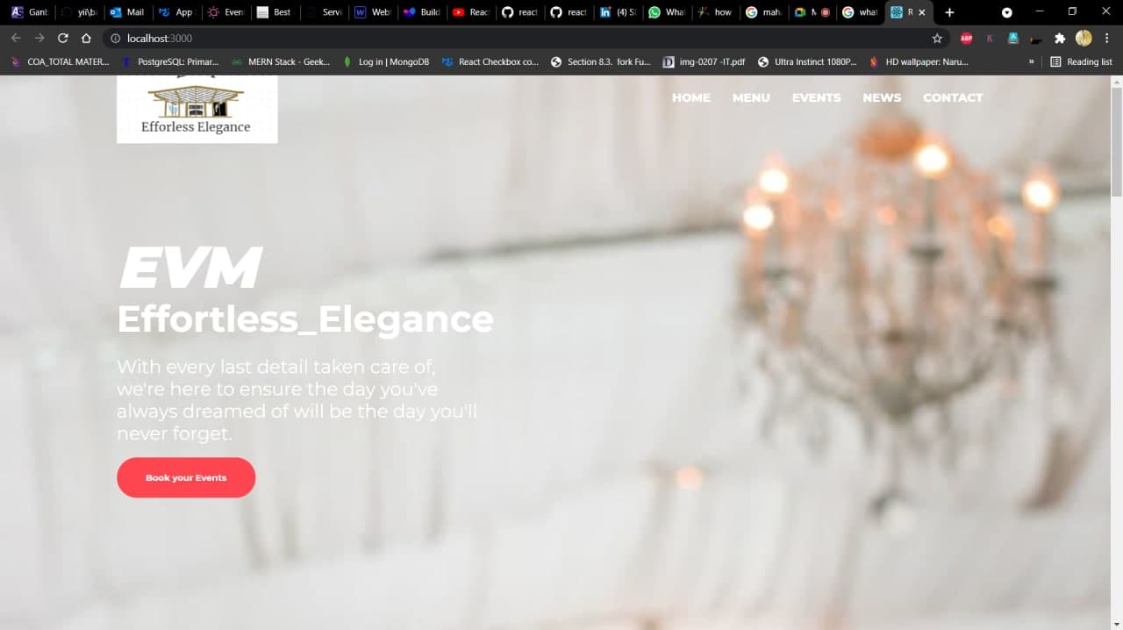
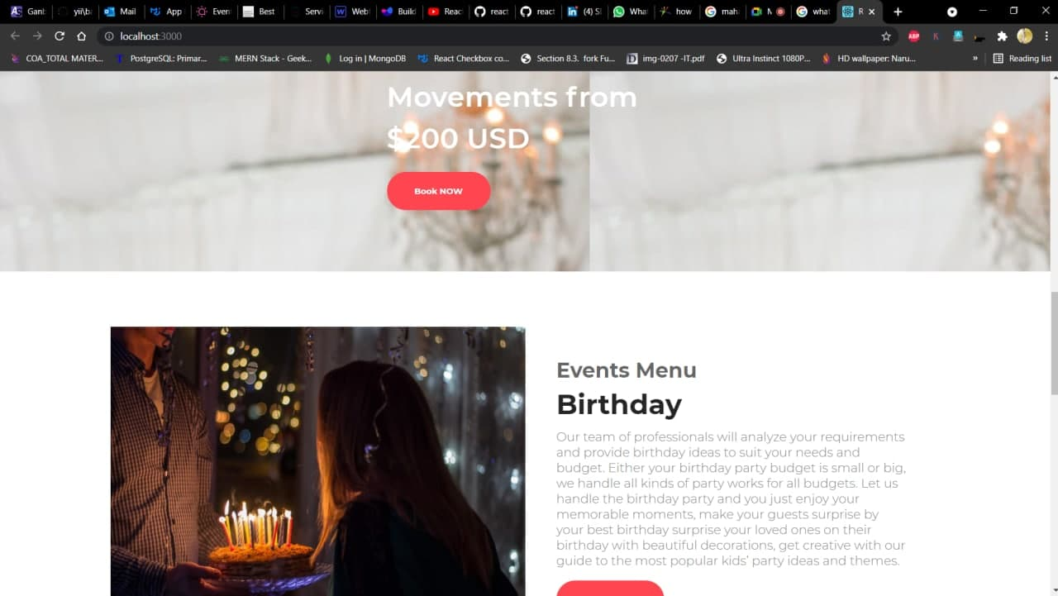
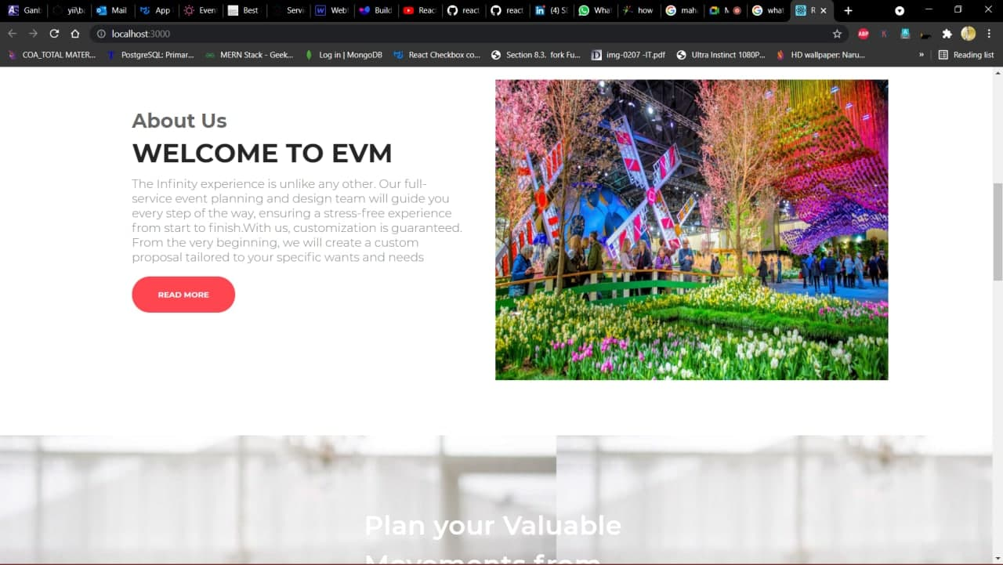
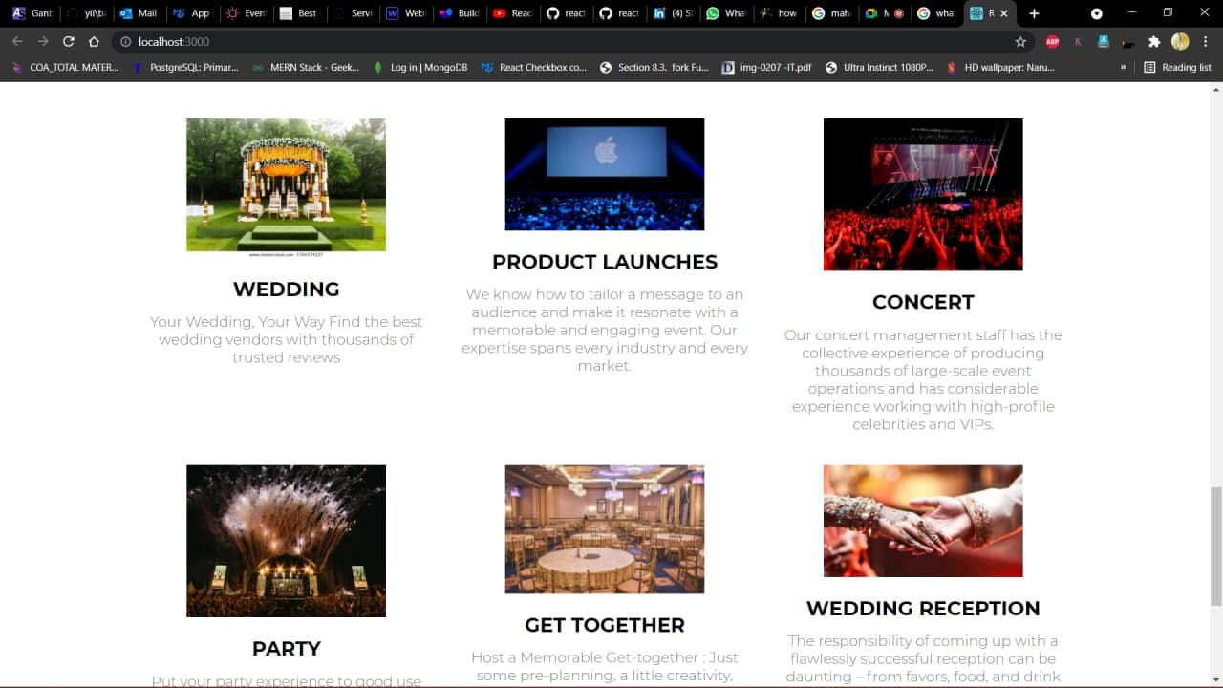
Our website Initial Build

Slide 9
Implementation of USECASE
We have developed a initial build of our Web-Application on basis of the Use-Case And included the modules that helps the clients to gain an easy access to their requirement when browsing through the website .A Login System is developed to store the event history and transaction details from customer-customer. To ensure the secure transaction of event-booking a portal has been developed. A genuine feedback option been available for the clients to review the application or the service provided.
The Admin can directly manage all the data on the application along with a manager.

Slide 10
User stories-1
As a user, I can login to the website using the login credentials and to make choose of the event type according to the requirement.
As a user I think the user interface of this website is ease to use and trust worthy.
The payment portal is well secured and provide better service.
As a user while booking a slot for the event I whish there would be a free slot.
As a user, I can select the payment method as per my comfort and finalize the booking.

Slide 11
User stories-2
As a developer I want to provide a user friendly interface for the customer comfort.
As a developer I want to provide continues service by maintaining standards of the software.
As a developer I work on new updates for better user experience and provide new versions of the web application in a time period.
As a developer I want assure the data security, privacy and data maintenance of the user.

Slide 12
Analysis
BUDGETS FOR EVENT PLANNING
CONSIDERATION OF DATE FOR EVENT AND PLANNING
SITE SELECTION FOR THE EVENT
PLANNING THE SOLUTIONS FOR PROBLEMS
EVALUATING & FEEDBACK OF THE EVENT

Slide 13
THANK YOU

